Slide 1
SYTEMS ANALYSIS AND DESIGN
REQUIREMENTS DISCOVERY

Slide 2
REQUIREMENTS DISCOVERY
The process and techniques used by systems analysts to identify or extract system problems and solution requirements from the user community.
System requirement – something that the information system must do or a property that it must have. Also called a business requirement.

Slide 3
Characteristics of System Analyst in Requirements Determination
Impartiality: Fairness is important, consider issues raised by all parties, your job is to find the best solution to a business problem and not to for example, justify the purchase of new hardware, or impose your views on users.

Slide 4
Relax Constraints:- Assume that anything is possible and eliminate the infeasible. Avoid statements like we have always done it that way. Traditions are different from rules and policies. Organizations and environments change, traditions can turn into habit rather than sensible procedures

Slide 5
Reframing:- Analysis is a creative process. You must challenge yourself to look at the organization in new ways. You must consider how each user views his her requirements. Avoid jumping to the conclusion that the new system must work the same way as the one you have built before

Slide 6
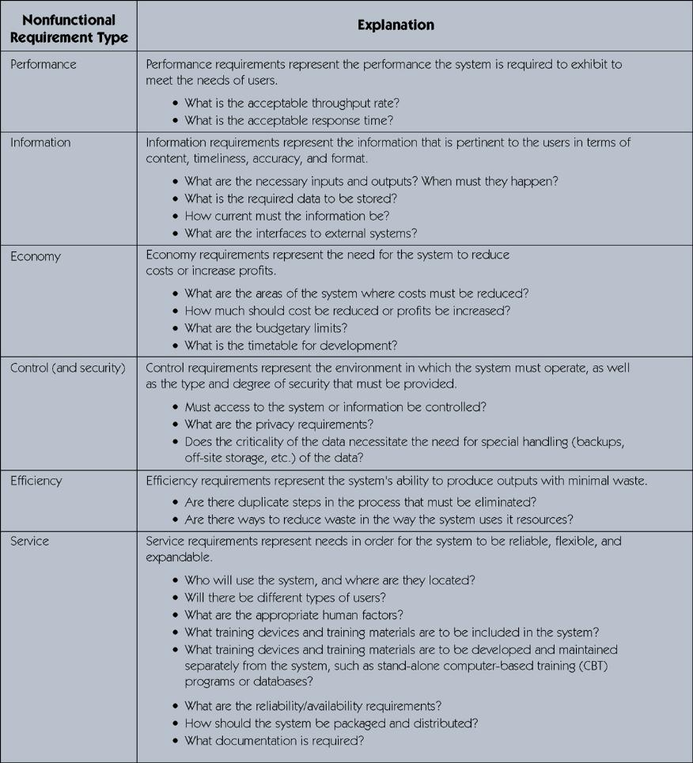
PIECES CLASSIFICATION OF requirements discovery

Slide 7
Results of incorrect requirements discovery
The system may cost more than projected.
The system may be delivered later than promised.
The system may not meet the users’ expectations and that dissatisfaction may cause them not to use it.
Once in production, the costs of maintaining and enhancing the system may be excessively high.

Slide 8
Results of incorrect requirements discovery….
The system may be unreliable and prone to errors.
The reputation of the IT staff on the team is tarnished because any failure, regardless of who is at fault, will be perceived as a mistake by the team.

Slide 9
Criteria to Define System Requirements
Complete – requirements describe all possible system inputs and responses.
Consistent – requirements are not conflicting or ambiguous.
Feasible – requirements can be satisfied based on the available resources and constraints.

Slide 10
Criteria to Define System Requirements…..
Required – requirements are truly needed and fulfill the purpose of the system.
Accurate – requirements are stated correctly.
Traceable – requirements directly map to the functions and features of the system.
Verifiable – requirements are defined so they can be demonstrated during testing.

Slide 11
FACT FINDING
The formal process of using research, meetings, interviews, questionnaires, sampling, and other techniques to collect information about system problems, requirements, and preferences. It is also called information gathering or data collection.

Slide 12
Fact-Finding Ethics….
Fact-Finding often brings systems analysts into contact with sensitive information.
  Company plans
  Employee salaries or medical history
  Customer credit card, social security, or other information

Slide 13
Fact-Finding Ethics….
Ethical behavior includes:
  Systems analysts must not misuse that information.
  Systems analysts must protect that information from people who would misuse it.

Slide 14
Fact-Finding Ethics……
Otherwise:
  Systems analyst loses respect, credibility, and confidence of users and management, impairing ability to do job
  Organization and systems analyst could have legal liability
  Systems analyst could lose job

Slide 15
Information can be got from:-
(1) Existing documents e.g.
Organization charts
Policy manuals
Procedural manuals
Job descriptions
Forms, reports
Document flow and work flow diagrams

Slide 16
Information can be got from:-…..
Systems flow charts
If computerized
  Computer program documentation
  Data dictionary listings
  Computer operation manuals

Slide 17
Information can be got from:-….
(2) System users and managers
(3) External sources: Might be necessary especially when examining alternatives for the new systems. To see what is available
Other companies
Equipment and software vendors
Business publications, seminars, workshops, or visits to show rooms, exhibitions, or other companies for demonstrations.

Slide 18
Methods of Gathering Information: The existing systems must be understood before they can be comprehensively designed. The best way of understanding the activities that take place in any particular system whether computerized or manual is to get information from the users and other processing areas.

Slide 19
Fact finding methods
Sampling of existing documentation, forms, and databases.
Research and site visits.
Observation of the work environment.
Questionnaires.
Interviews.
Prototyping.
Joint requirements planning (JRP).

Slide 20
Sampling
Sampling – the process of collecting a representative sample of documents, forms, and records.
  Organization chart
  Memos and other documents that describe the problem
  Standard operating procedures for current system

Slide 21
Sampling…
  Completed forms
  Manual and computerized screens and reports
  Samples of databases
  Flowcharts and other system documentation
  And more

Slide 22
Why blank forms?
Can determine the type of data going into each blank
Can determine the size of data going into each blank
Can determine which blanks are not used or not always used
Can see data relationships

Slide 23
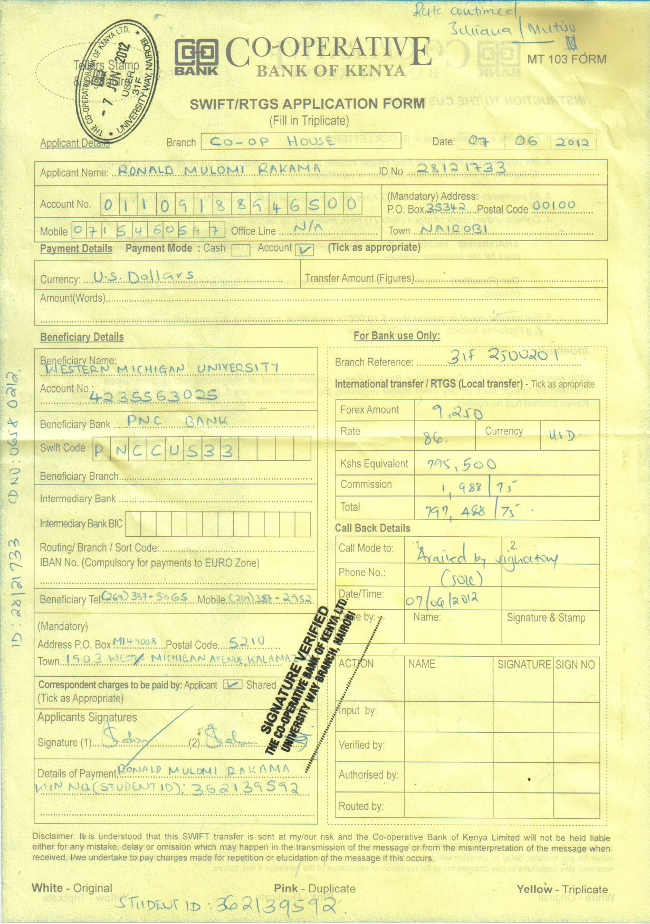

Slide 24
Observation
Observation – a fact-finding technique wherein the systems analyst either participates in or watches a person perform activities in order to learn about the system.

Slide 25
Guidelines to observation
Determine the who, what, where, when, why, and how of the observation.
Obtain permission from appropriate supervisors or managers.
Inform those who will be observed of the purpose of the observation.
Keep a low profile.

Slide 26
Guidelines to observation….
Take notes during or immediately following the observation.
Review observation notes with appropriate individuals.
Don't interrupt the individuals at work.
Don't focus heavily on trivial activities.
Don't make assumptions.

Slide 27
Advantages of Observation
Data gathered is highly reliable.
The system analyst can see exactly what happens especially for tasks, which are difficult to explain in words.
It allows the system analyst to do some measurements or estimations.
It is relatively inexpensive compared to other techniques.
The analyst gets first hand information.

Slide 28
Disadvantages of Observation
Tendency of people to exaggerate behavior when they know they are being observed.
The activities may take place at odd hours hence inconveniencing the analyst.
The system analyst may end up observing exceptional activities only.
It is subject to bias opinion.

Slide 29
Questionnaire
Questionnaire – a special-purpose document that allows the analyst to collect information and opinions from respondents.

Slide 30
Types of Questions
Open-ended question – a question that allows the interviewee to respond in any way that seems appropriate.
Closed-ended question – a question that restricts answers to either specific choices or short, direct responses.

Slide 31
When to Use Questionnaires
When the system analyst is located at a considerable distance from the staff to be questioned.
When there is a large number of respondents such that interviewing is prohibited by the time available.

Slide 32
When to Use Questionnaires…
When the questions are simple and they call for direct answer.
When limited amount of information is required from a large number of people.
When it is to be used as a means of verifying information found or gathered using other methods

Slide 33
Advantages of Questionnaires
They provide inexpensive method of gathering data from a large number of people.
Allows individuals to maintain your identity (anonymity) hence they can provide real facts.
The questions are presented consistently to all the respondents without bias.
The respondents can complete the questionnaire at their own convenience

Slide 34
Disadvantages of Questionnaires….
The number that responds is often too low.
They provide no opportunity for clarification.
It is not possible for the analyst to observe and analyze body expressions
There is no guarantee that the individuals will respond to all the questions.
Good questionnaires are difficult to prepare.

Slide 35
Interviews
Interview - a fact-finding technique whereby the systems analysts collect information from individuals through face-to-face interaction.
  Can be used to:
    Find facts
    Verify facts
    Clarify facts

Slide 36
Interviews….
    Generate enthusiasm
    Get the end-user involved
    Identify requirements
    Solicit ideas and opinions

Slide 37
Types of interviews
Unstructured interview – an interview that is conducted with only a general goal or subject in mind and with few, if any, specific questions. The interviewer counts on the interviewee to provide a framework and direct the conversation.
Structured interview – an interview in which the interviewer has a specific set of questions to ask of the interviewee.

Slide 38
Procedure to Conduct an Interview
Select Interviewees
  End users
  Learn about individual prior to the interview
Prepare for the Interview
  An interview guide is a checklist of specific questions the interviewer will ask the interviewee.

Slide 39
Procedure to Conduct an Interview….
3. Conduct the Interview
  Summarize the problem
  Offer an incentive for participation
  Ask the interviewee for assistance
4..Follow Up on the Interview
  Memo that summarizes the interview

Slide 40
Interview Questions
Types of Questions to Avoid
  Loaded questions
  Leading questions
  Biased questions

Slide 41
Interview Question Guidelines
  Use clear and concise language.
  Avoid long or complex questions.
  Avoid threatening questions.
  Don’t include your opinion as part of the question.
  Don’t use “you” when you mean a group of people.

Slide 42
The do’s of interviews
Be courteous
Listen carefully
Maintain control
Probe
Observe mannerisms and nonverbal communication
Be patient
Keep interviewee at ease
Maintain self-control

Slide 43
Don’ts of interviews
Continuing an interview unnecessarily.
Assuming an answer is finished or leading nowhere.
Revealing verbal and nonverbal clues.
Using jargon

Slide 44
Don’ts of interviews….
Tape recording -- a sign of poor listening skills.
Revealing your personal biases.
Talking instead of listening.
Assuming

Slide 45
Communicating With the User
Guidelines for Communicating
  Approach the Session with a Positive Attitude
  Set the Other Person at Ease
  Let Them Know You Are Listening
  Ask Questions
  Don’t Assume Anything
  Take Notes

Slide 46
Communicating With the User…
“To hear is to recognize that someone is speaking, to listen is to understand what the speaker wants to communicate.” (Gilder sleeve)

Slide 47
Advantages of Interviews
It is effective in answering how and why types of questions.
It provides an immediate feedback.
The problem is understood clearly because the interviewee is able to explain what he or she wants the system to do.
It eliminates panic, resistance and fear because of greater user involvement.

Slide 48
Disadvantages of Interviews
It can be time consuming if many people are to be interviewed one by one.
It might be difficult to get to the interviewee or the organization e.g. many branches of an organization.
Some people want to be perceived in their best right, hence giving wrong information.
It is possible to forget some important details during interview.
Inconsistent answers from individuals

Slide 49
Disadvantages of Interviews…
One option available to the last point group interview where all the key people are interviewed at once or Nominal Group Technique:- a facilitated process that supports idea generation by groups. At the beginning of the process group members work alone to generate ideas which are then pooled under the guidance of a trained facilitator

Slide 50
When to Use Interviews
When the respondents are very few
When the interviewees are physically available.
When the main emphasis of system investigation is people.
When the system analyst wants to seek direct opinion or answers.
When the system analyst wants to verify the validity of the facts collected using other techniques.
When immediate response is required.

Slide 51
Rapid Prototyping
A prototype is a working version of a system (working model)
It performs the same basic tasks that the finished system would perform but ignores such features as: Efficient, Calculations, Security, Error Handling and Program and User documentation.
The skeleton version “dummies” the internal processing while concentrating on portraying user screens and reports.

Slide 52
Prototype
A prototype is easy to built and use because of the 4GLs and the many software tools on the market. It is appropriate for online systems because of their strong user interface. For example, they require multitude of input and output screens, as well as reports on paper.

Slide 53
Prototype….
A prototype can clarify user requirements (by verifying that the finished product will meet those requirements). It also gets users interested in the system, by the analyst demonstrating what is expected.

Slide 54
Prototyping
They are user centered, the analyst and user work closely together. It evolves through a process of iteration or refinements, functions are added one by one as deeper understanding of the system emerges. It gives a user the experience of using the actual system

Slide 55
Prototyping…
It is good with systems with high uncertainty (where user and designer are not sure of what is required of the system). A lot of errors occur in such systems. Uncertainty can be reduced by reducing errors and omissions.

Slide 56
Prototyping….
Three stages of prototyping:
Prototype the user interface (screens/reports) using dummies for programs
Include functional programs
Expand to become a finished product

Slide 57
Prototyping….
Features that are initial left out are: User documentation, Help screens, security/controls, backup procedures, ability to handle large volumes of data. If added then it would be a finished product.

Slide 58
Prototyping….
If it evolves into a finished product, all the phases of designing a system are left out and the approach is called Rapid Application Development (RAD). RAD systems are grown not built. That is systems design and construction is evolutionary refinement rather than a step by step process.

Slide 59
Prototyping…
With this approach, the finished product is less expensive, and is completed in less time; lifetime maintenance will also be inexpensive. Limitations of 4GLs make large systems hard to prototype

Slide 60
Prototyping…..
For example, some execute slowly, consume memory, and prevent other parts of the system from executing in a timely fashion. These problems are magnified as the system is expanded. Therefore, it is wrong to assume that the finished product will execute as fast as versions of steps one and two.

Slide 61
Prototyping….
Prototypes whose performances are unacceptable should only be used for demonstration of the new system. Part or all of it should be recorded in a standard procedural language.
Whether used or not, a prototype is a useful tool to use when designing a system. It can be used as a model, or to build user confidence and verify omissions etc.

Slide 62
Advantages of prototypes
Heavy user involvement means a more complete, accurate and friendly user interface
Prototyping may discover user needs that users were not previously aware of
Users feel more confident approving a system they can try out
Users have a more positive attitude towards any system that they helped to create

Slide 63
Advantages of Prototyping….
Prototyping often results in a development project that costs less and takes less time to built
A system prototyped during information gathering is cheaper to maintain because of fewer errors and omissions
A prototype that evolves into a finished product is inexpensive to maintain because a system coded in a 4TH generation language is easier to modify than one coded in a third generation language

Slide 64
Disadvantages of Prototyping
Users may not want to invest the time and effort that prototyping requires of them
A prototype that evolves to a full system may execute slowly, consume memory, and prevents other parts of the system from executing in a timely version

Slide 65
Disadvantages of Prototyping….
Often fourth generation prototypes must be recorded in a third generation language in order to improve performance
Prototyping is often inappropriate for systems that require complex algorithms for processing

Slide 66
Joints Requirements Planning
Joint requirements planning (JRP) – a process whereby highly structured group meetings are conducted for the purpose of analyzing problems and defining requirements.
  JRP is a subset of a more comprehensive joint application development or JAD technique that encompasses the entire systems development process

Slide 67
Joints Requirements Planning….
JAD is similar to group interview, however, it follows a particular structure of roles and agenda and usually involves all the stake holders. JAD session leader, users, managers, sponsor, system analyst, scribe, IS staff. The end result of JAD is a set of documents containing details of the working of the current system and detailed information on what is desired of the new system

Slide 68
Steps to Plan a JRP Session….
Selecting a location
  Away from workplace when possible
  Requires several rooms
  Equipped with tables, chairs, whiteboard, overhead projectors
  Needed computer equipment

Slide 69
Steps to Plan a JRP Session….
Selecting the participants
  Each needs release from regular duties
Preparing the agenda
  Briefing documentation
  Agenda distributed before each session

Slide 70
Brainstorming
Sometimes, one of the goals of a JRP session is to generate possible ideas to solve a problem.
  Brainstorming is a common approach that is used for this purpose.

Slide 71
Brainstorming…
Brainstorming – a technique for generating ideas by encouraging participants to offer as many ideas as possible in a short period of time without any analysis until all the ideas have been exhausted.

Slide 72
Brainstorming Guidelines
Isolate the appropriate people in a place that will be free from distractions and interruptions.
Make sure everyone understands the purpose of the meeting.
Remind everyone of brainstorming rules.
Appoint one person to record ideas.

Slide 73
Brainstorming Guidelines…
Within a specified time period, team members call out their ideas as quickly as they can think of them.
After the group has run out of ideas and all ideas have been recorded, then and only then should the ideas be analyzed and evaluated.
Refine, combine, and improve the ideas that were generated earlier.

Slide 74
Benefits of JRP
JRP actively involves users and management in the development project (encouraging them to take “ownership” in the project).
JRP reduces the amount of time required to develop systems.

Slide 75
Benefits of JRP…
When JRP incorporates prototyping as a means for confirming requirements and obtaining design approvals, the benefits of prototyping are realized
JAD is a user centered design- continual user involvement in systems development

Slide 76
Benefits of JRP…
CASE tools can be used during the JAD sessions, for example diagramming tools, prototyping tools and form and report generators. The analyst can use these tools to give graphical forms of system requirements, and make changes depending on the users reactions. Illustrations of what the alternative system will look like provides the analyst with information that can assist in selection of the best alternative

Slide 77
Benefits of JRP…
The major problem with JAD is that the more the people in a group, the less time there is for them to speak and state their views. A few people dominate the discussion and some will say absolutely nothing. The decision will be tilted towards those who speak most, while some of them may not be fully committed to the conclusions. Some might be afraid to criticize their boss in public, even if what is being said is wrong

Slide 78
Business Process Reengineering
The search for and implementation of, radical change in business process to achieve breakthrough improvements in products and services. This can be achieved through creative application of information technologies. BPR also suggest that radical improvement can only be achieved by using a clean sheet of paper and not by modifying the existing system

Slide 79
Disruptive Technologies
Technologies that enable the breaking of long-held business rules that inhibit organizations from making radical business changes, for example, only experts can perform complex work or only managers can make decisions or field officers need offices for data transactions. There are Expert systems and decision support tools or virtual office for workers.

Slide 80
A Fact-Finding Strategy
Learn from existing documents, forms, reports, and files.
If appropriate, observe the system in action.
Given all the facts that have been collected, design and distribute questionnaires to clear up things that aren’t fully understood.

Slide 81
A Fact-Finding Strategy…
4. Conduct interviews (or group work sessions).
5. (Optional). Build discovery prototypes for any functional requirements that are not understood or for requirements that need to be validated.
6. Follow up to verify facts.

Slide 82
Deliverables and Outcomes
Information Collected from conversations or observation of users
Existing written information
Computer based information: results from JAD, CASE reports, displays and reports from prototyping
All the resulting data has to be organized in order to be useful. This is done by structuring system process requirements by modeling and feasibility assessment

Slide 83
THE END
THANK YOU

